Slide 1

Security System for House key’s
Presented By : The Assembly Team

Slide 2
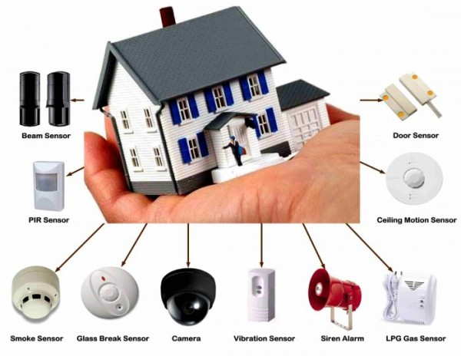
Types of Security System

Slide 3
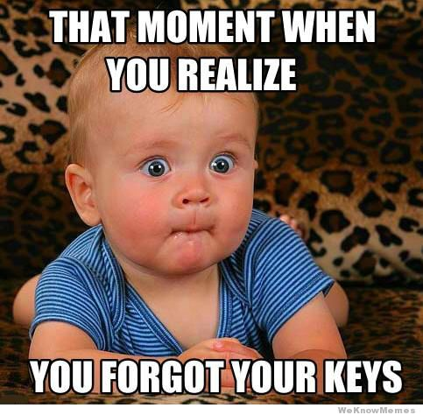
Security System for Keys??

Slide 4
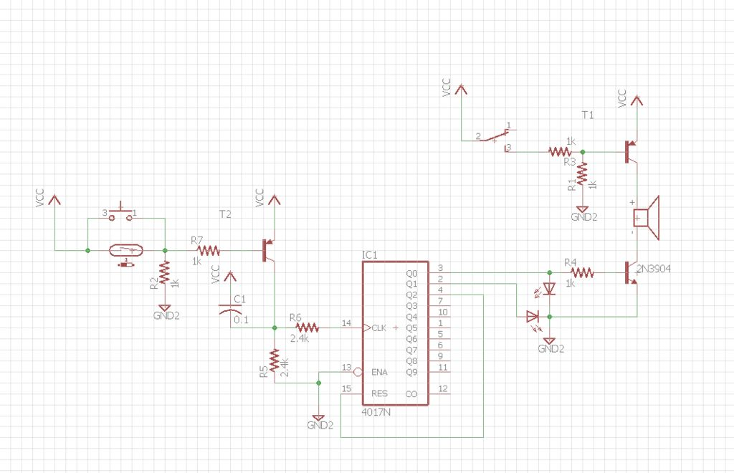
How does it Work??
Notes:
*The HC-06 acts as a serial port through which you can send and receive data.
*So using a serial terminal or a Bluetooth customized application on your computer or phone, you can control and monitor your project.
*HC06 functions only as slave to a microcontroller

Slide 5
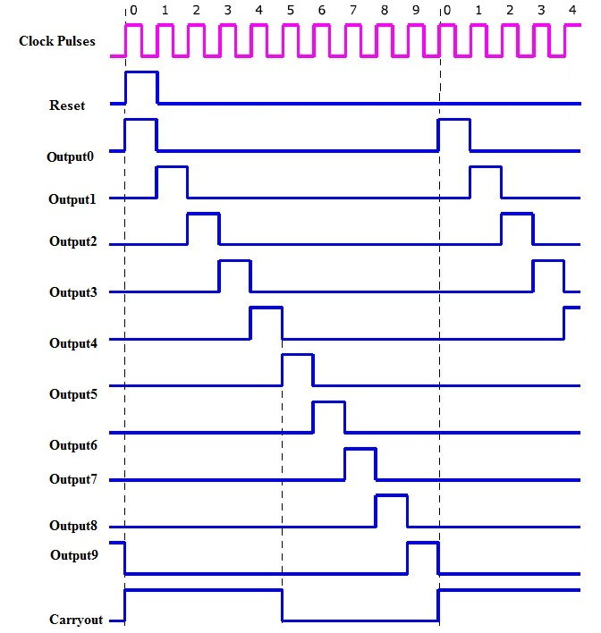
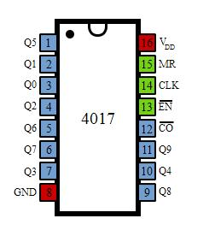
CD4017

Slide 6
Transistors

Slide 7
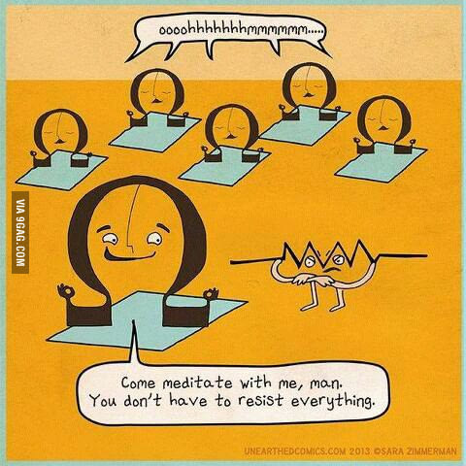
Resistor

Slide 8
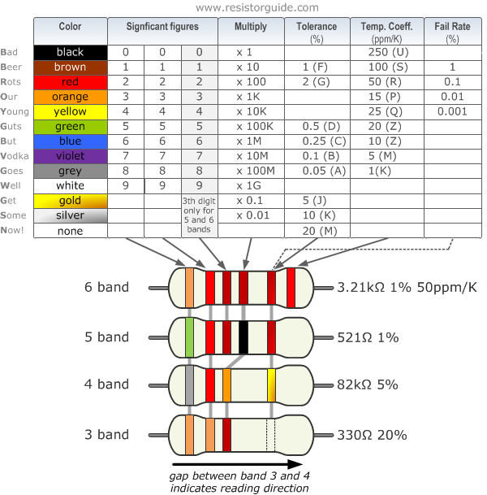
`

Slide 9
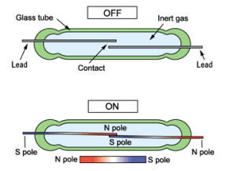
Reed Switch

Slide 10
Let’s circuit

Slide 11

THANK YOU

